Slide 1
ERCOT North Hub LMP Forecasting
Christopher Chen
Proof of Concept Exercise
for Candidacy/Application to Senior Trading Analyst

Slide 2
Executive Summary
Initial descriptive statistical analysis suggests North Hub DA and RT LMPs have a distribution that bests matches a Cauchy distribution. The LMPs include very extreme outliers that suggest trading can be very risky.
We implemented and analyzed a cross-sectional multiple linear regression model for RT LMPs. This model performs poorly in statistical and economic metrics due to the presence of the extreme outlier RT LMP points.
Suggested next steps:
Try non-linear (LOESS) models that also incorporate lagged/averaged LMP variables.
Develop a more strategically-oriented model, such as a classification model that predicts when RT LMPs will be at the extreme elevated levels, or a time series models that accounts for recency.
Ideally, more data (years) would allow development of better-performing models and more comprehensive risk assessment

Slide 3
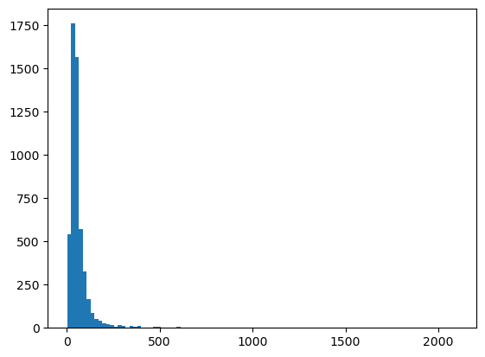
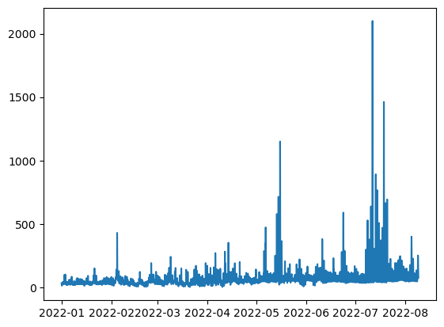
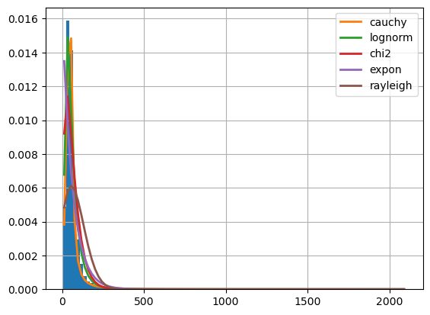
Descriptive statistics: North Hub DA LMP
Histogram
Time series
Statistic | Value
Min | 2.37
Max | 2100.11
Mean | 65.10
Variance | 7997.70
Standard Deviation | 89.42
Skewness | 10.22
Kurtosis | 160.72
Best fit distribution: Cauchy
 | sumsquare_error | aic | Bic | ks_statistic | ks_pvalue
cauchy | 0.000011 | 2315.065108 | -105672.426905 | inf | 0.122231
lognorm | 0.000020 | 3315.830221 | -102294.646970 | inf | 0.067046
chi2 | 0.000071 | 6011.625945 | -95639.107489 | inf | 0.129338

Slide 4
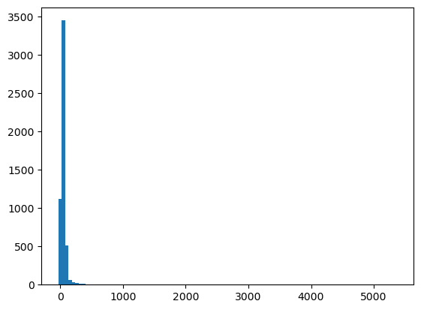
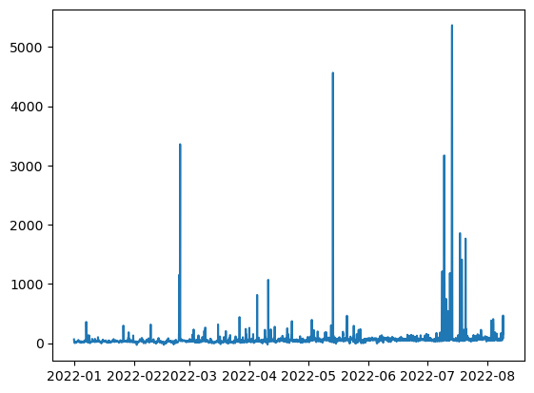
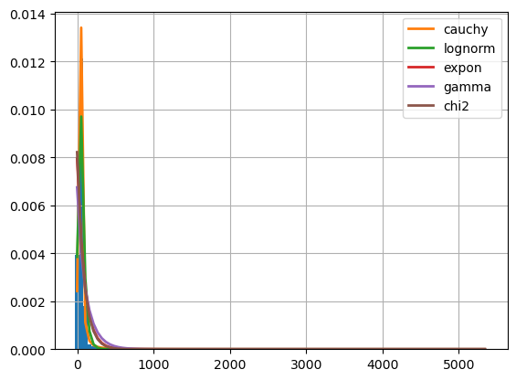
Descriptive statistics: North Hub RT LMP
Histogram
Time series
Statistic | Value
Min | -29.695
Max | 5365.85
Mean | 64.95
Variance | 41989.70
Standard Deviation | 204.89
Skewness | 17.08
Kurtosis | 353.40
Best fit distribution: Cauchy
 | sumsquare_error | aic | Bic | ks_statistic | ks_pvalue
cauchy | 0.000004 | 2693.677994 | -110258.846871 | 0.109433 | 1.714325e-55
lognorm | 0.000007 | 6332.225972 | -107484.655424 | 0.100807 | 3.886906e-47
expon | 0.000077 | 6614.853938 | -95190.897439 | 0.302555 | 0.000000e+00

Slide 5
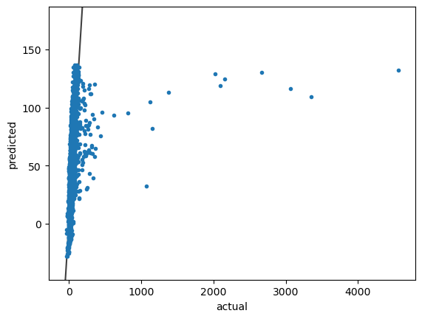
Multiple Linear Regression Model of RT LMP, with Lasso Regularization
Training actuals vs pred
Used an 80% chronological training split, and standardized the predictors/independent variables
Used Scikit-learn’s LassoCV function. Includes 5-fold Cross Validation
R² train: 0.064 (low)
RMSE train: 125.75 (vs training std of 129.99)
Poor performance on validation set of next 10% of data (different season, Jun-26 to Jul-17)
RMSE val: 496.34 (vs validation std 502.01)
MAE val: 109.25
Economics: assuming a 1MW bid in both directions at prediction:
Overall -22048.21 loss on validation, -41.75 per hour.
-24411.03 Max drawdown, -114.15 VAR (very bad)
variable | coefficient
ERCOT (SOLAR_STPPF_BIDCLOSE) | -9.240834
WEST (ERCOT) (WIND_STWPF_BIDCLOSE) | -7.778419
GR_PANHANDLE (WIND_STWPF_BIDCLOSE) | -7.493543
WZ_North (BIDCLOSE_LOAD_FORECAST) | 1.145549
Katy (GASPRICE) | 2.877271
WZ_Coast (BIDCLOSE_LOAD_FORECAST) | 12.431082
ERCOT (TOTAL_RESOURCE_CAP_OUT) | 13.822987
WZ_NorthCentral (BIDCLOSE_LOAD_FORECAST) | 18.538149
intercept | 49.707049

Slide 6
Recap
Initial descriptive statistical analysis suggests North Hub DA and RT LMPs have a distribution that bests matches a Cauchy distribution. The LMPs include very extreme outliers that suggest trading can be very risky.
We implemented and analyzed a cross-sectional multiple linear regression model for RT LMPs. This model performs poorly in statistical and economic metrics due to the presence of the extreme outlier RT LMP points.
Suggested next steps:
Try non-linear (LOESS) models that also incorporate lagged/averaged LMP variables.
Develop a more strategically-oriented model, such as a classification model that predicts when RT LMPs will be at the extreme elevated levels, or a time series models that accounts for recency.
Ideally, more data (years) would allow development of better-performing models and more comprehensive risk assessment

